Slide 1
Analysis of Tips
Anthony Davis and Tyson Jeffrey
STAT 311

Slide 2
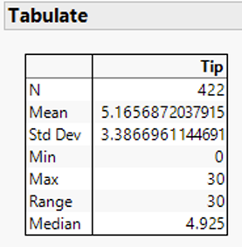
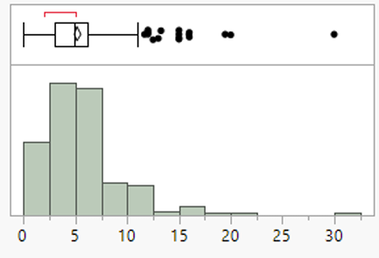
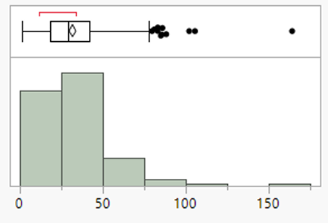
Dataset
Waitress Tips
422 Responses
$5.17 average

Slide 3
Research Questions
Can we find a statistically significant relationship between the given information and the mean tip amount?
Do any of our variables show significant interaction that would improve our model without compromising simplicity?
Are there any outliers in data or issues regarding assumed normal distribution with the data we have?

Slide 4
Variables
Day – Day of the week
Meal – lunch, dinner, late night
Payment – Cash, Credit, Credit w/ Cash Tip
Age – Young Adult, Middle, Senior
Gift Card – was one used
Comps – were complimentary items given
Bday – were free birthday items given
Bill – bill amount in $
Tip percentage – in decimal form
Tip – tip amount in $

Slide 5
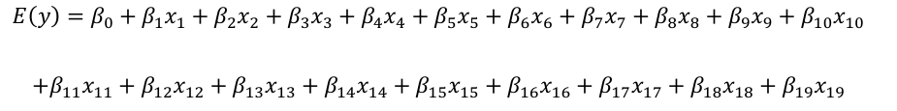
Model 1
Simple
All variables
No interaction

Slide 6
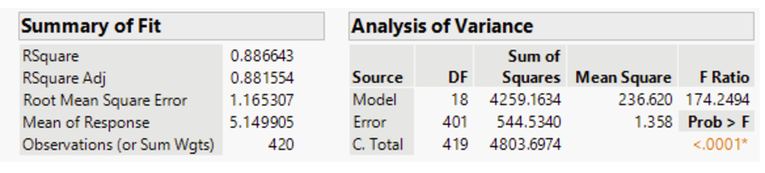
Model 1 Results

Slide 7
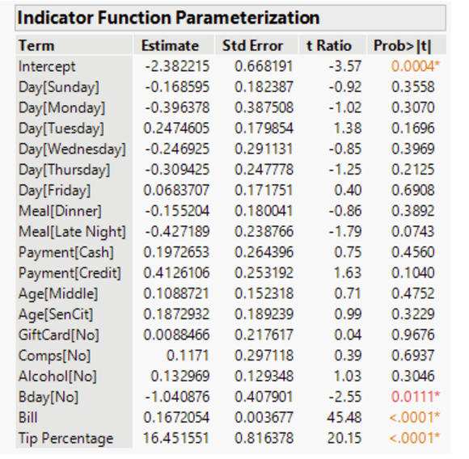

Slide 8

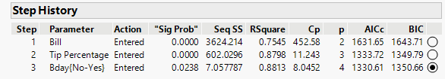
Model 2
Stepwise
Less variables

Slide 9
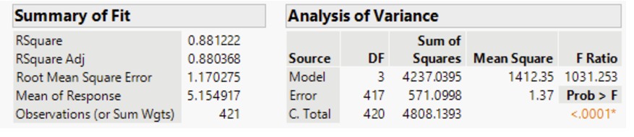
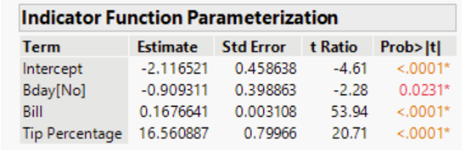
Model 2 Results

Slide 10
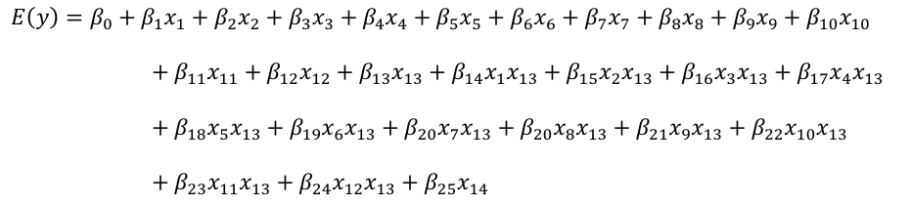
Model 3
Added interactions

Slide 11
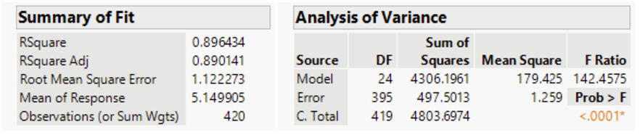
Model 3 Results

Slide 12
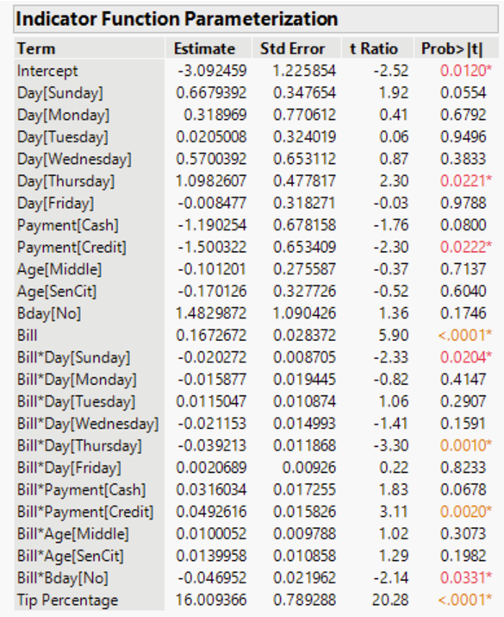

Slide 13
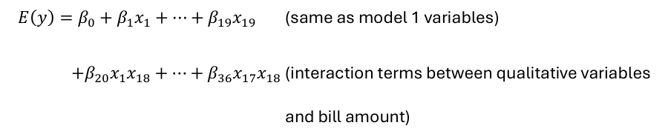
Model 4
Builds on Model 1 with interactions

Slide 14
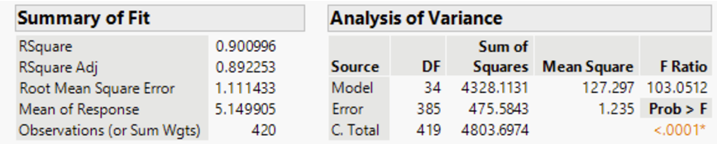
Model 4 Results

Slide 15
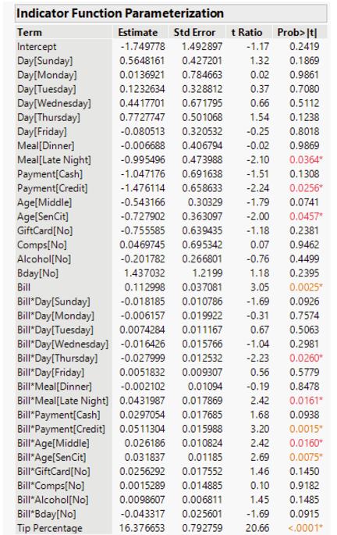

Slide 16
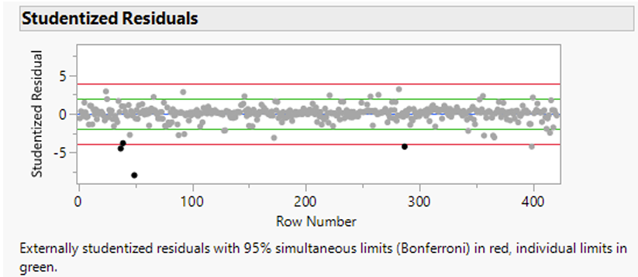
Model 2 Outliers
Model 2 Residuals
Rows 37, 39, 49, and 287

Slide 17
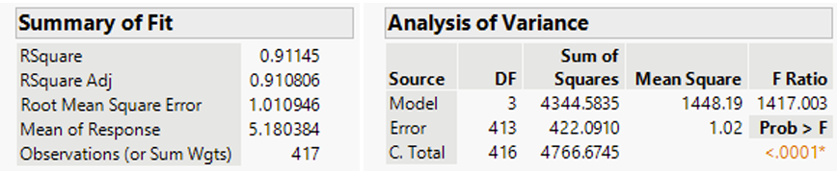
Model 2 Revised
After outliers removed​
F Ratio increase​
Adjusted r increase​
RMSE decrease

Slide 18
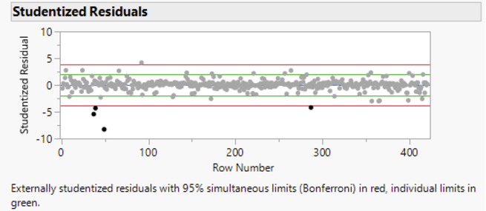
Model 3 Outliers
Model 3 Residuals
Rows 37, 39, 49, and 287

Slide 19
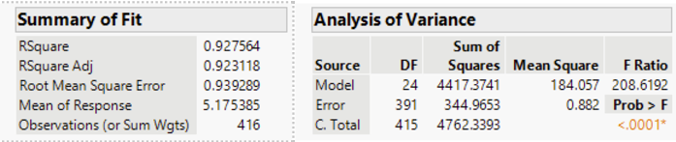
Outliers Continued
Model 3 after outliers removed
F Ratio increase
Adjusted r increase
RMSE decrease

Slide 20
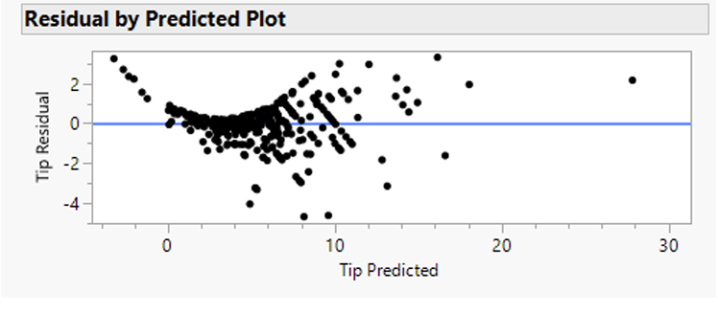
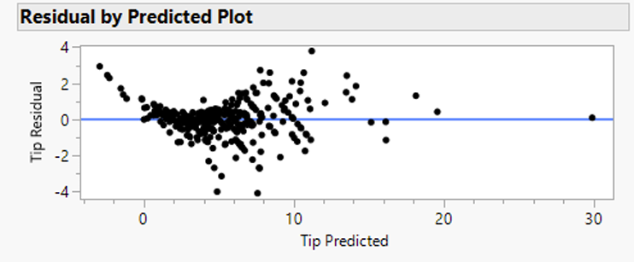
Residual vs Predicted
Model 2
Model 3

Slide 21
Conclusion
If a more precise model is needed/desired, model 3 appears to be the best option.
On the other hand, model 2 is a much simpler model that sacrifices minimal accuracy while only needing 3 terms.

